Slide 1
CS 170 Segment 5 Optimizing Search
Notes based from Dr. Eamonn Keogh

Slide 2
Optimizing Search (iterative improvement algorithms) I.E Hill climbing, Simulated Annealing, Genetic Algorithms
Optimizing search is different to the path finding search we have studied in many ways
The problems are ones for which exhaustive and heuristic search are NP-hard
The path is not important (for that reason we typically don’t bother to keep a tree around) (thus we are CPU bound, not memory bound)
Every state is a “solution:
The search space can be continuous
Usually, we abandon hope of finding the best solution, and settle for a very good solution
The task is usually to find the minimum (or maximum) of a function

Slide 3
Optimization for CNC manufacturing
Please glance at this video so you can understand what CNC milling is
https://www.youtube.com/watch?v=arb3iXfbpbI
There are two problems where AI search can help
Part Layout. How can you arrandge the parts to reduce waste?
Tool Path Planning: How can you plan the tool movement to reduce wasted tool movement.

Slide 4
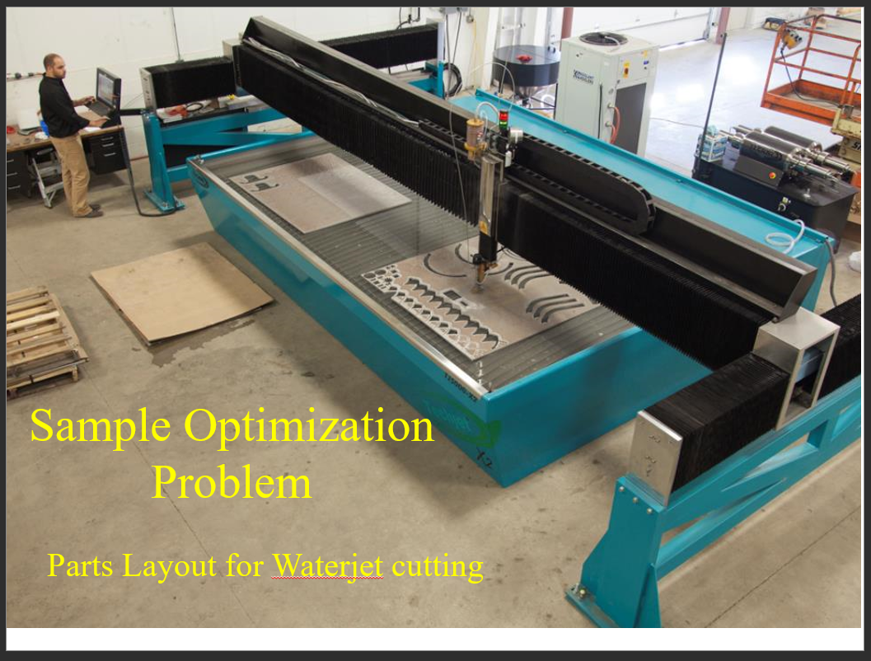

Slide 5
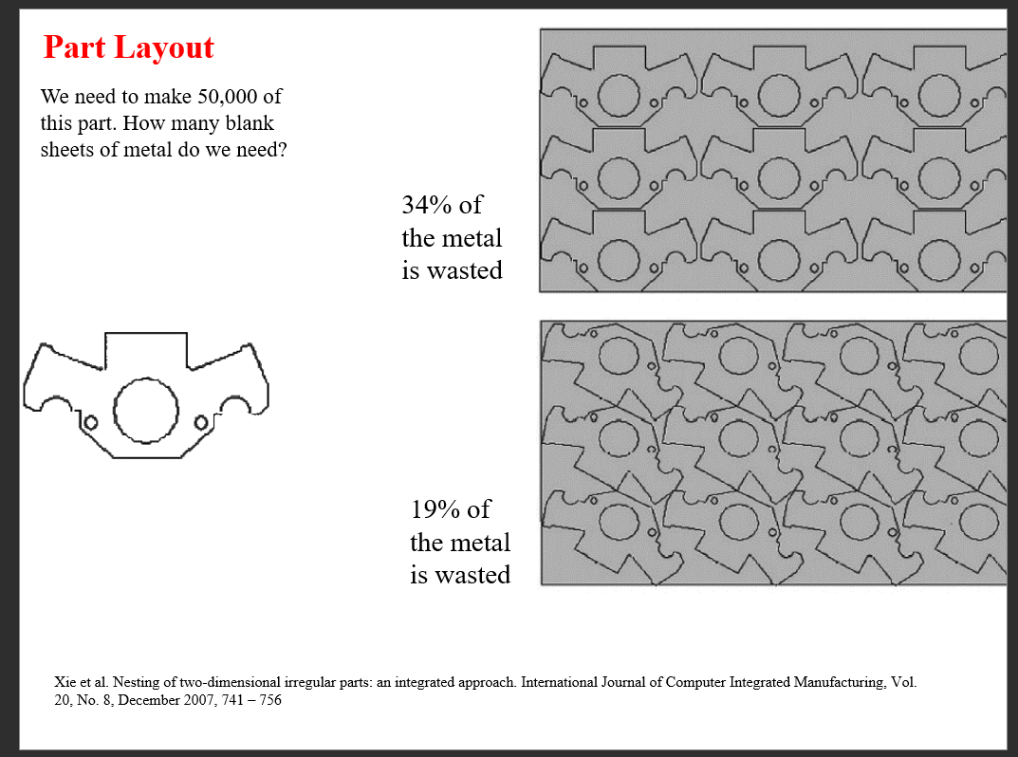

Slide 6
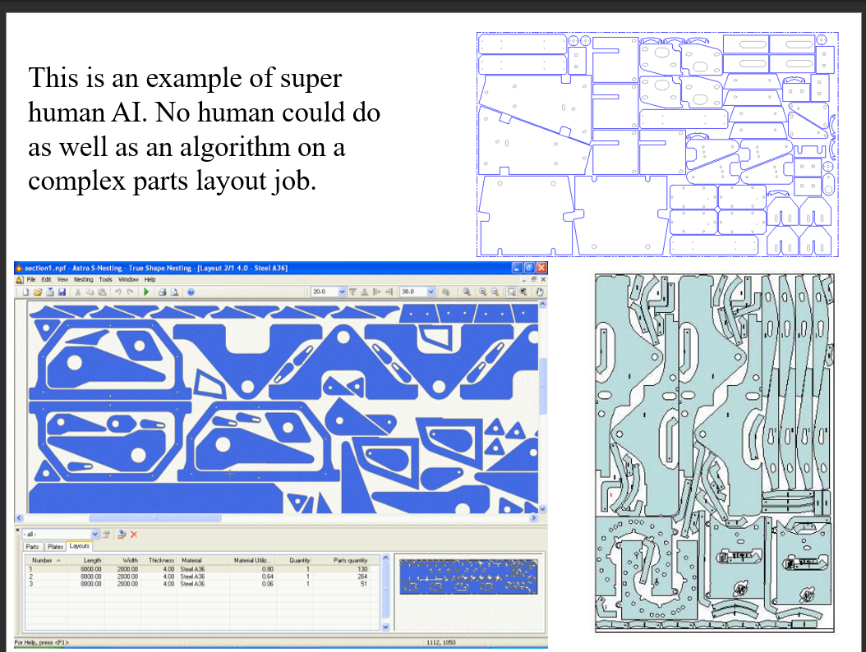

Slide 7
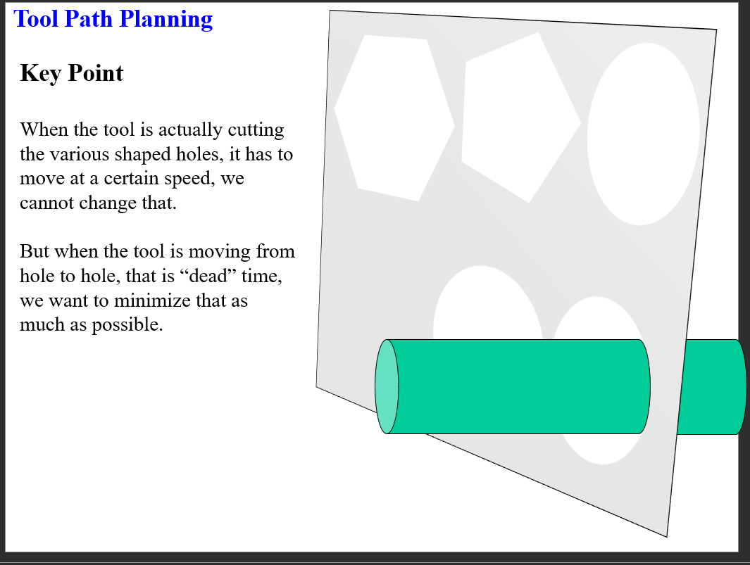

Slide 8
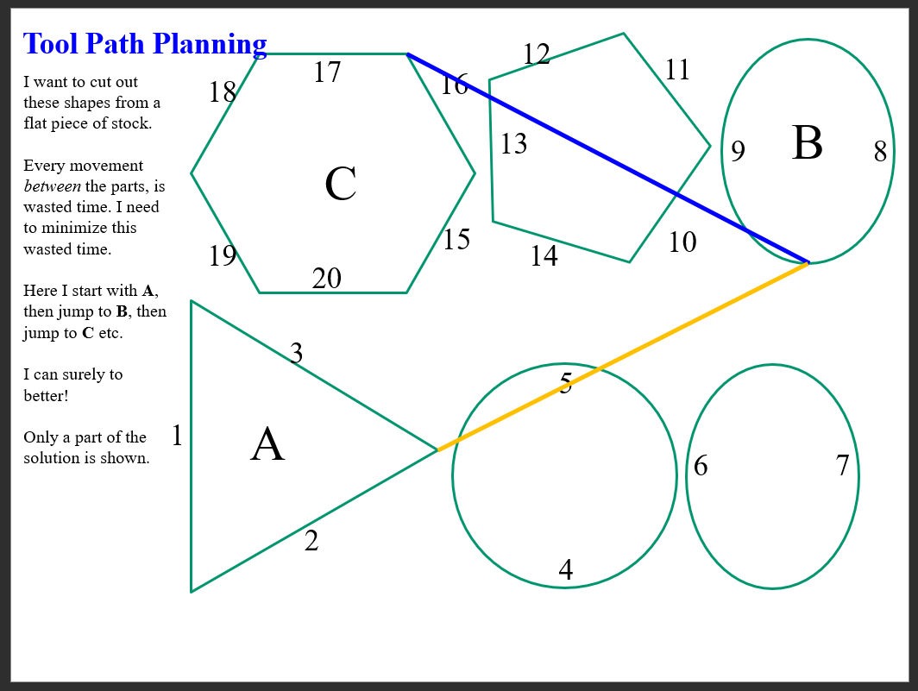

Slide 9
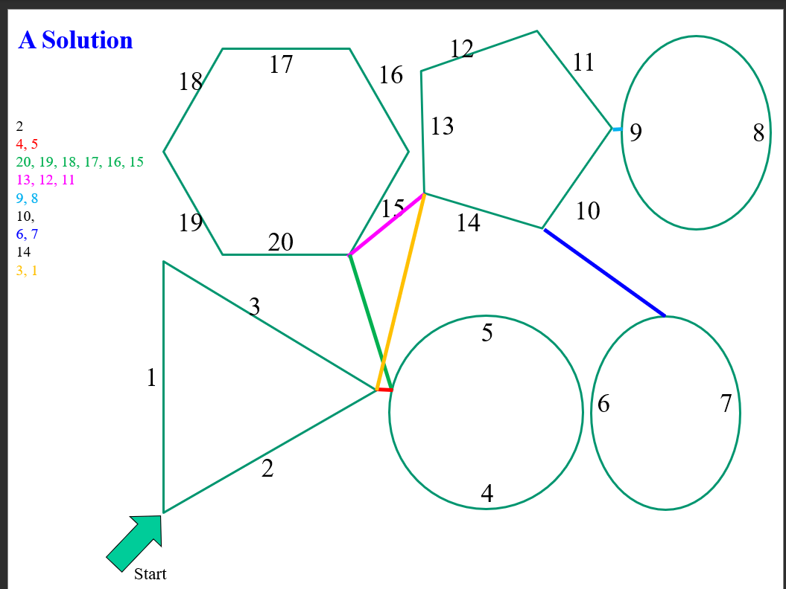

Slide 10
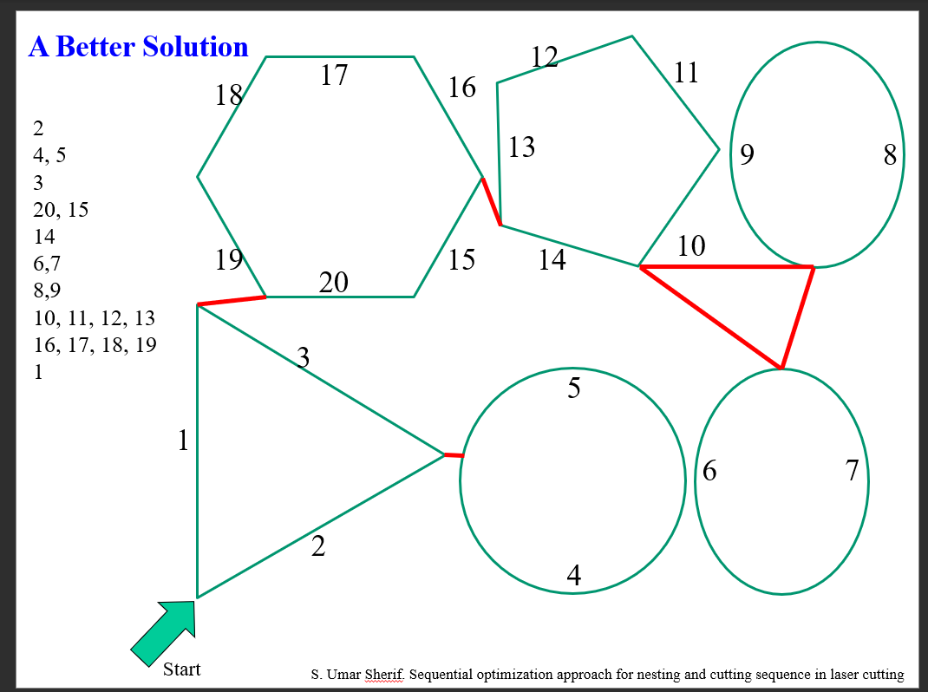

Slide 11
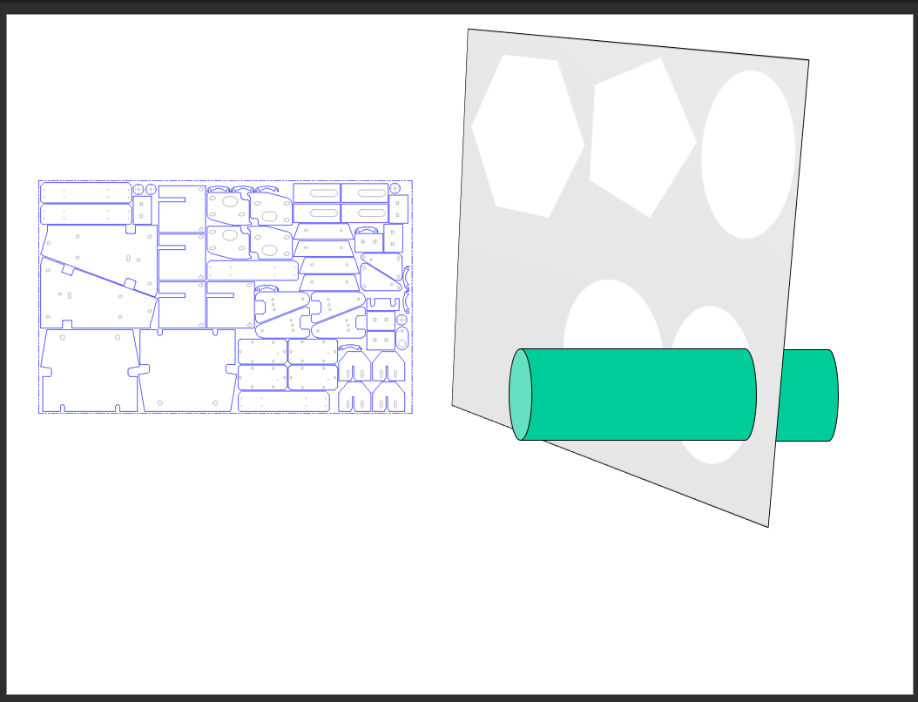

Slide 12
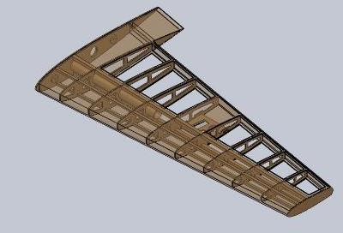
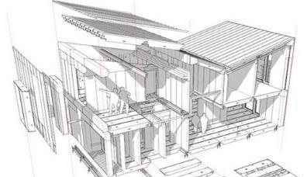
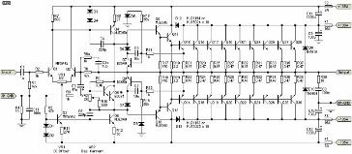
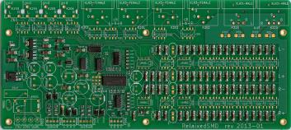
Background Info A
For many electrical, mechanical and physical systems we can model them essentially perfectly in a computer (a single model is a “state”)
This means we can ask questions such as:
For this wing design:
What is its lift coefficient?
What is its drag coefficient?
How much would it cost make?
What is its stall speed?

Slide 13
Background Info B
For these systems, we can do “what if” changes (changes are “operators”)
So we could make the wing 10% longer and then ask:
For this wing design:
What is its lift coefficient?
What is its drag coefficient?
How much would it cost make?
What is its stall speed?

Slide 14
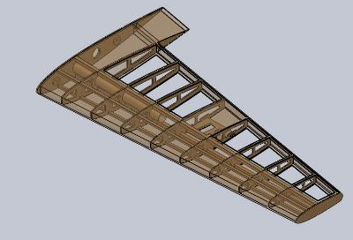
Background Info C
For these systems, we can come up with a single number that describes how good the solution is changes (this single number is a “fitness function”)
Creating this single number is often tricky, but not our job!
This single number is simply a weighted sum of the (suitably normalized) score on all the elements we care about:
A = lift coefficient
B = drag coefficient/10
C = cost to make/cost of 747 wing
D = 100mph – stall speed
Quality of Solution = A + 7B + 1/C + D^2

Slide 15
Background Info D
We can also model (but with more uncertainty) economic, business, social and political systems
Here the state might be the politician’s position
NRA ranking on guns
Planned parenthood scorecard
Tax Policy ranking
Congressional Scorecard on LGBT rights
Etc (these only includes things that can be changed)
Here the changes (operators) could include hardening stance on guns, or withdrawing objections to same-sex marriage etc
Here the quality of a solution (fitness) might be something like
Quality of solution = votesgained(CA) + votesgained(AR)
Note: votesgained(X) can be negative

Slide 16
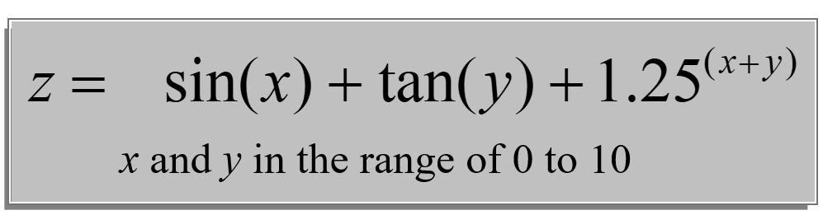
Imagine that I am in a good mood
Imagine that I am going to give you some money!
In particular I am going to give you z dollars after you tell me the value of x and y

Slide 17
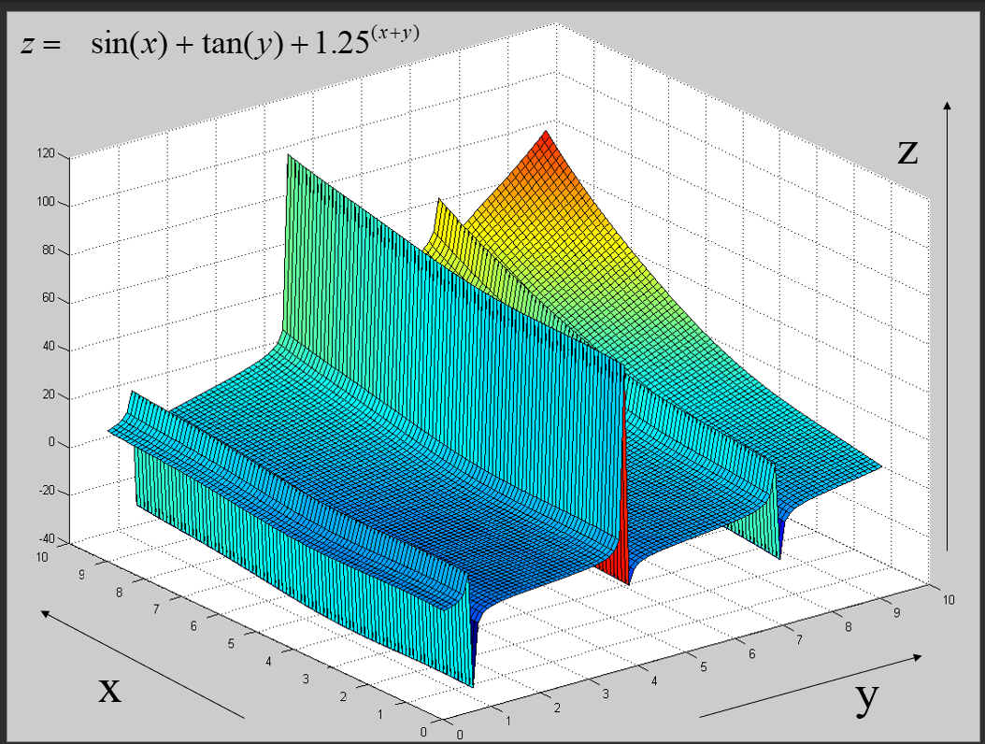

Slide 18
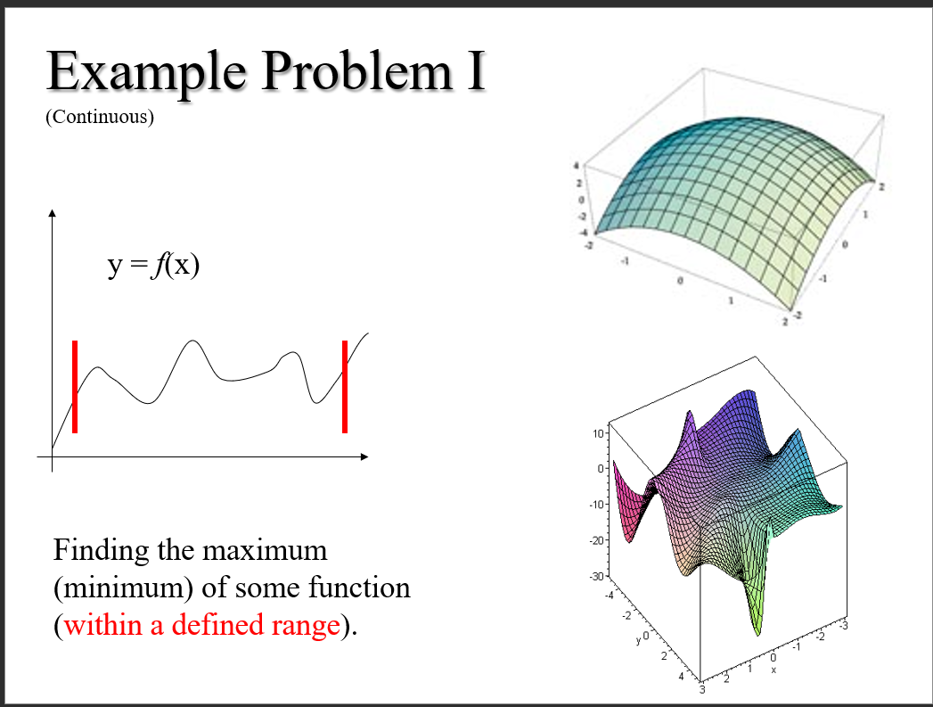

Slide 19
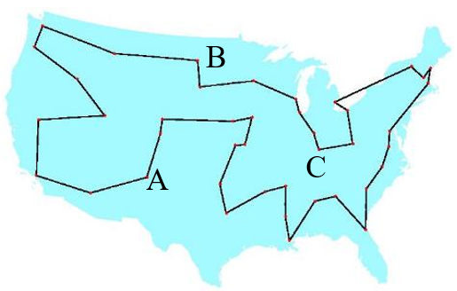
Example Problem II
(Discrete)
The Traveling Salesman Problem (TSP)
A salesman spends his time visiting n cities. In one tour he visits each city just once, and finishes up where he started. In what order should he visit them to minimize the distance traveled? There are (n-1)!/2 possible tours.
Note that we don’t need the map to solve this all we need is the distance matrix.

Slide 20
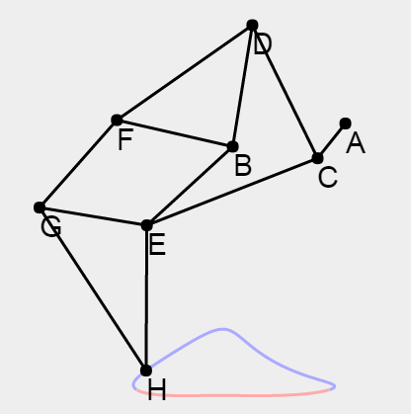
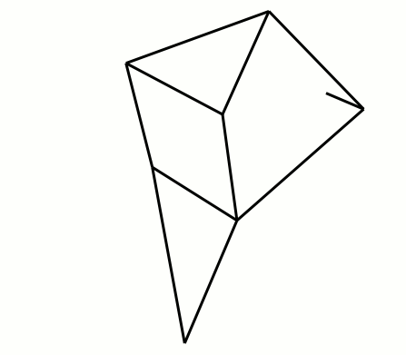
Example Problem III (Continuous)
Bx=-38;
By=-7.8;
AC=15;
CD=50;
BD=41.5;
BE=39.3;
CE=61.9;
DF=55.8;
BF=40.1;
FG=39.4;
EG=36.7;
GH=65.7;
EH=49;
Find the values of the following 13 parameters that make the device walk well. Bx, By, AC, CD, BD, CE, DF, BF, EG, GH, EH
http://garethrees.org/2011/07/04/strandbeest/strandbeest.html

Slide 21
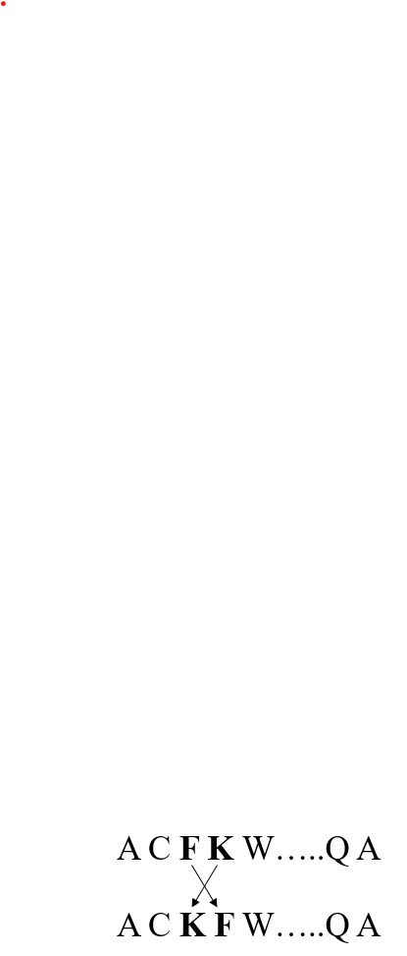
Assume that we can
Represent a state (could be a list of numbers, an equation, a tree, a set, a linked list, a graph, a computer program…)
Quickly evaluate the quality of a state
Define operators to change from one state to another
Function Optimizing
Traveling Salesman
z = log(x) + sin(tan(y-x))
x = 2;
y = 7;
log(2) + sin(tan(7-2)) = 2.00305
x = add_10_percent(x)
y = subtract_10_percent(y)
….
A C F K W…..Q A
A to C = 34
C to F = 142
…
Total 10,231

Slide 22
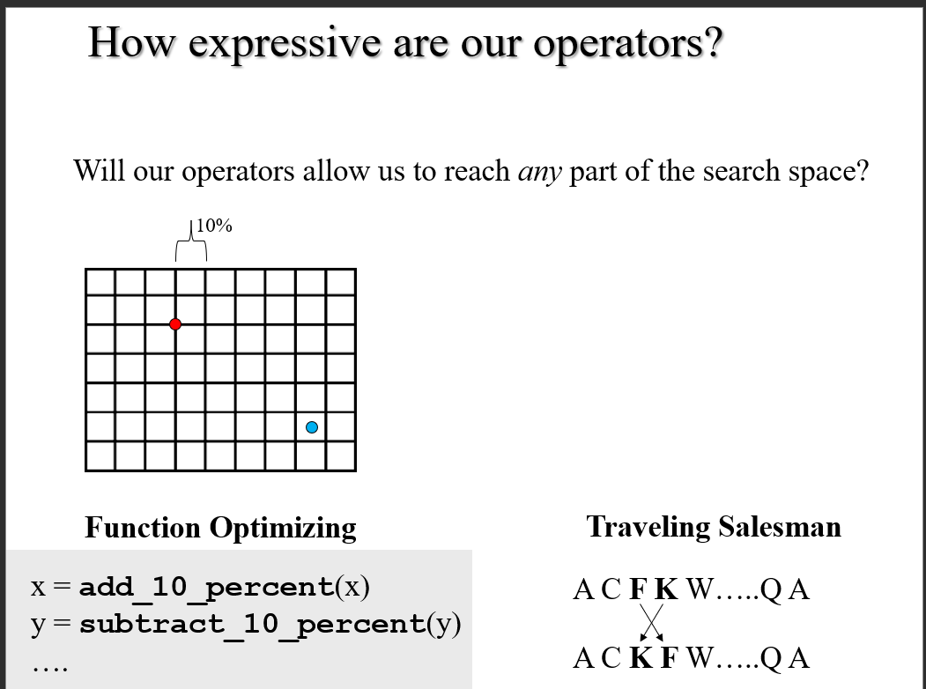

Slide 23
Preview
We are going to see two simple algorithms
Hill-Climbing (greed) search Fast, but not optimal
Random Search Optimal, but unbelievably slow
Does this remind you of anything?
For path planning search, we combined a fast but not optimal algorithm (greedy search) with a slow but optimal algorithm (uniform cost search) to make A-Star, a fast and optimal algorithm
We are later going to combine Hill-Climbing and Random Search into a single algorithm called Simulated Annealing, that is also “best of both worlds”

Slide 24
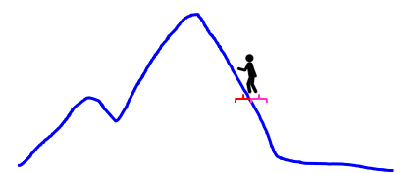
Hill Climbing
Function Hill-Climbing (problem) returns a solution state
Inputs: problem //a problem
local variables: current // a node
next //a node
current ← Make-Node (Initial-State [problem ]) // make random
loop do //initial state
next ← a highest-valued successor of current //try all operators
if value [next] < Value [current] then return current
current ← next
end

Slide 25
Random Search
function: Random Search (problem) returns a solution state
inputs: problem //a problem
local variables : current //a node
next //a node
current ← Make-Node (Initial-State [ problem ]) // make random
BSF ← -infinity // initial state
loop do // runs forever!
If BSF ← Value [next] then record (next’s state), update BSF.
current ← next
end

Slide 26
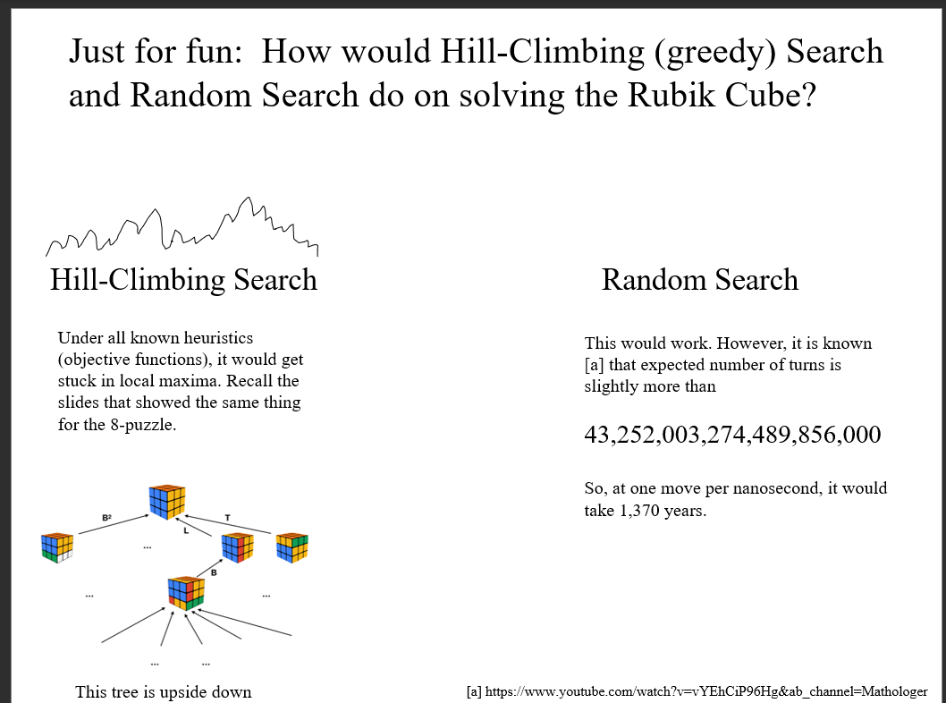

Slide 27
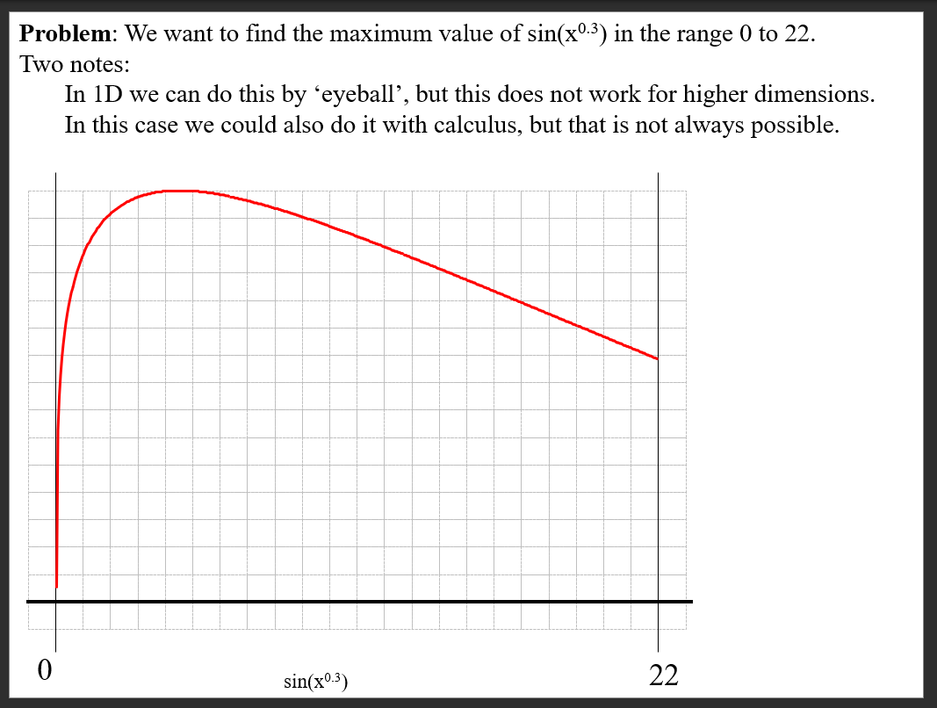

Slide 28
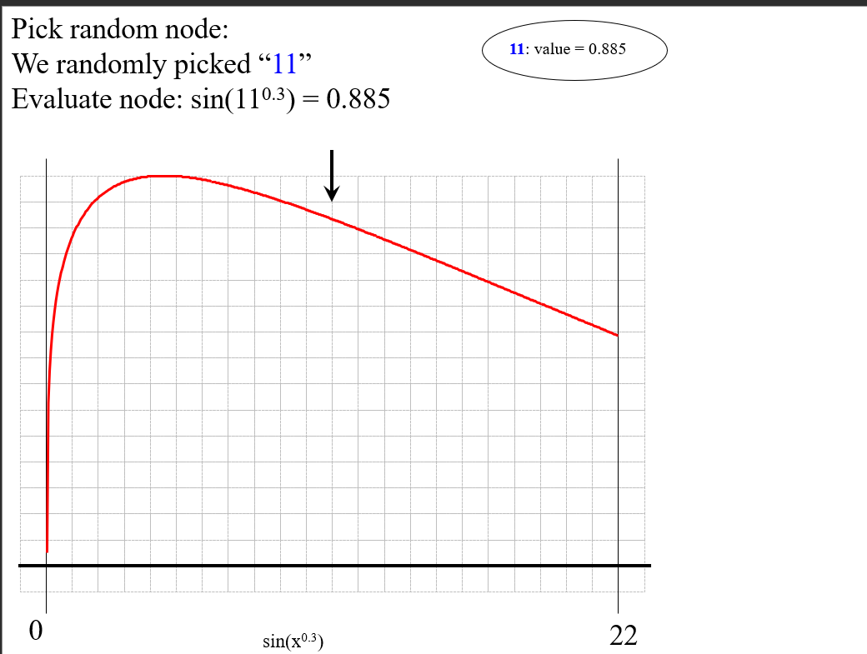

Slide 29
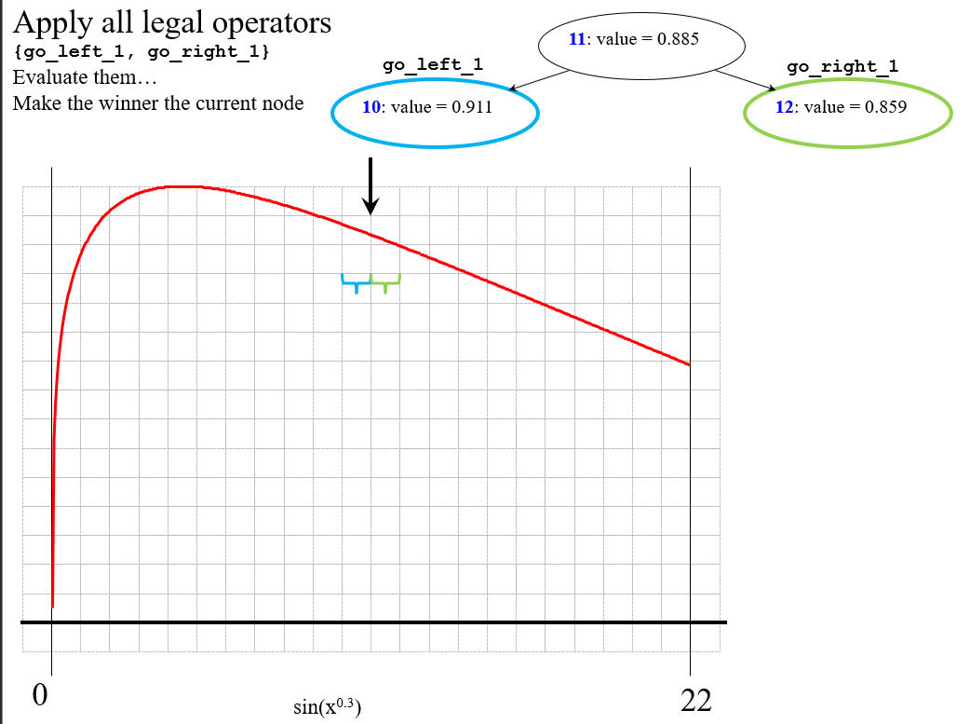

Slide 30
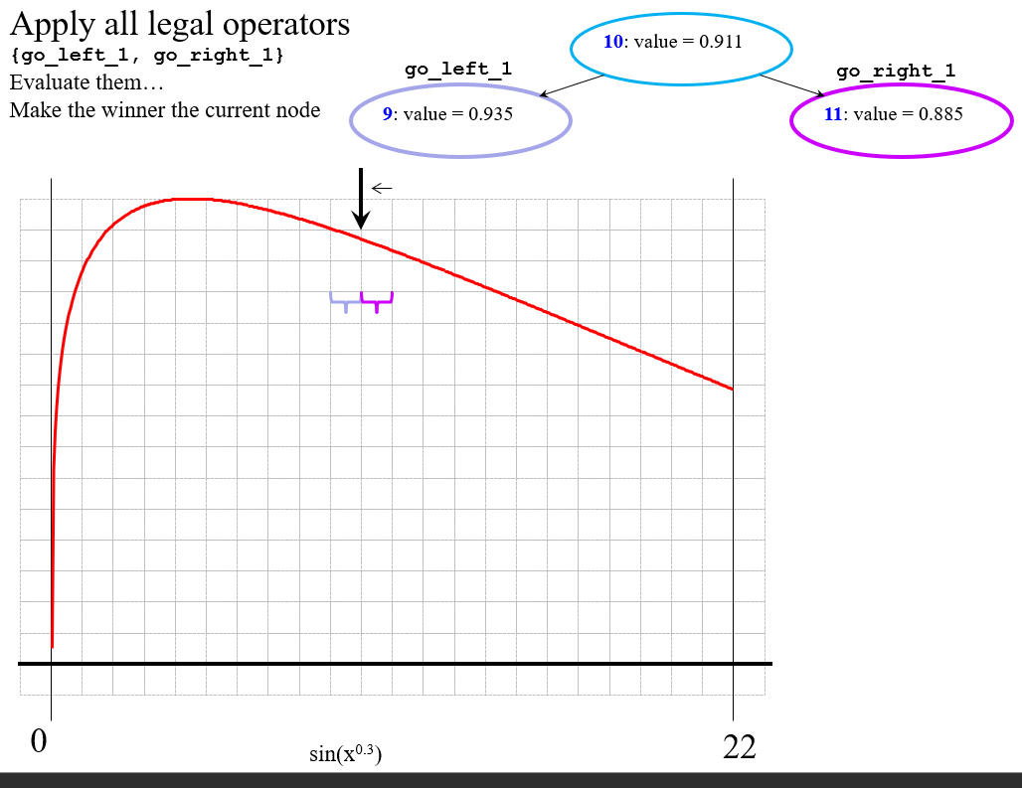

Slide 31
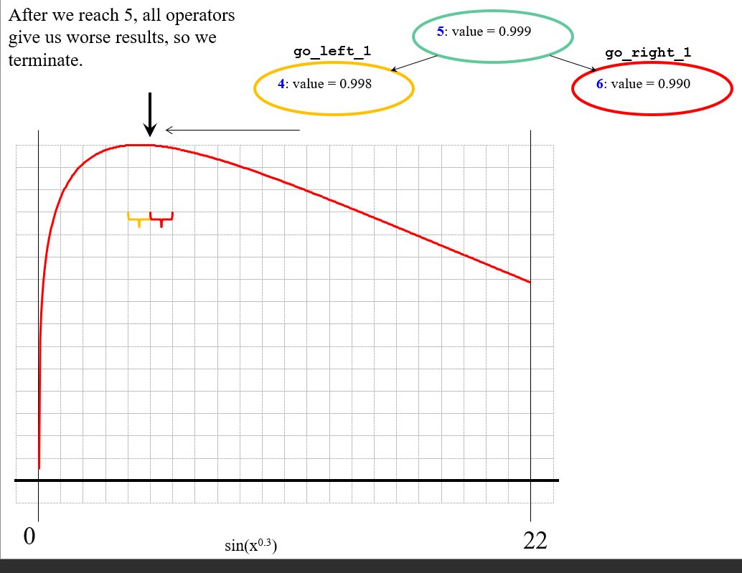

Slide 32
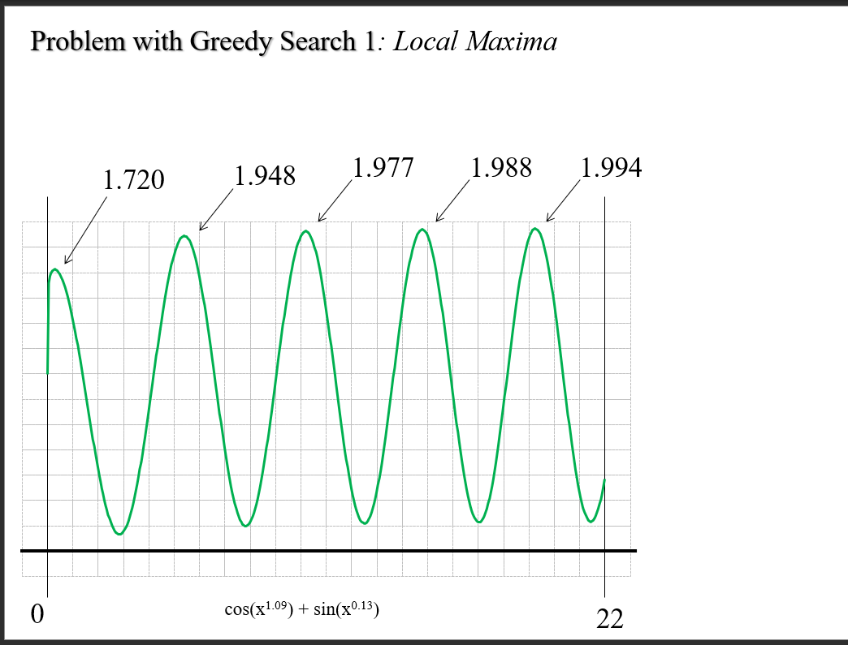

Slide 33
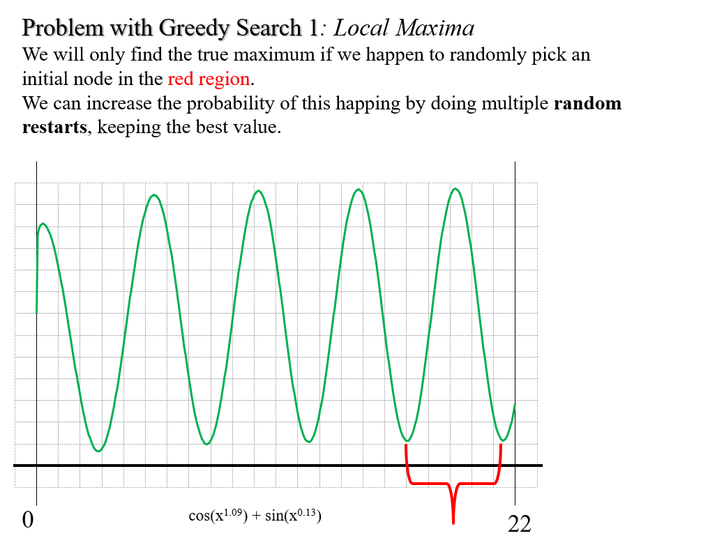

Slide 34
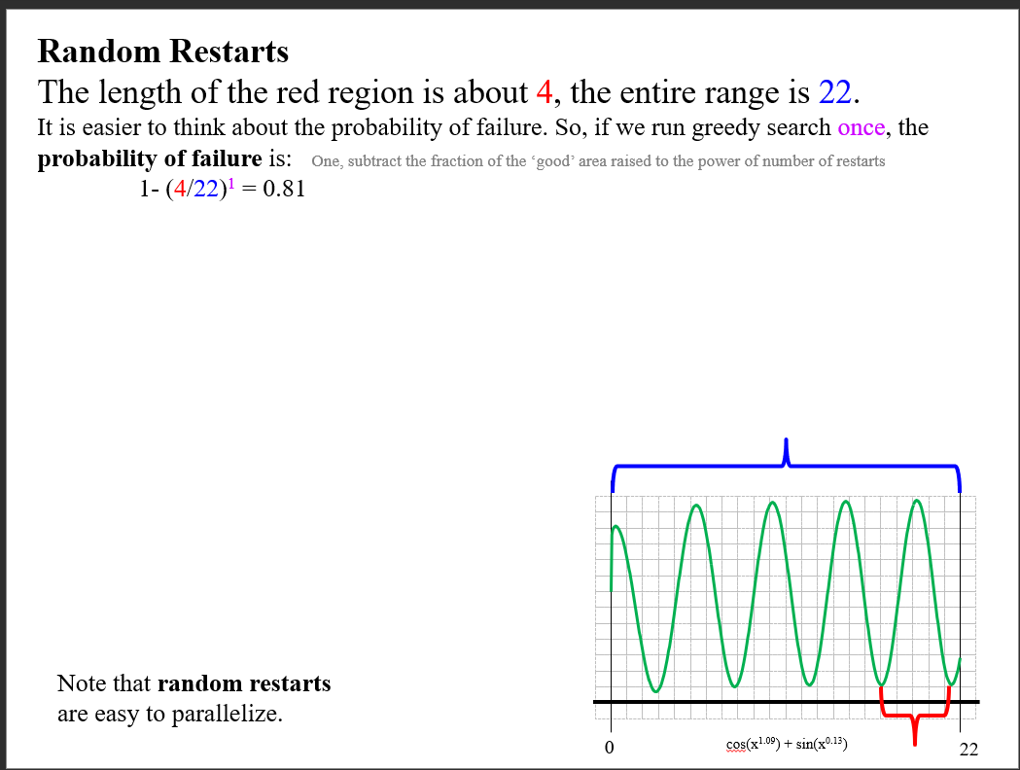

Slide 35
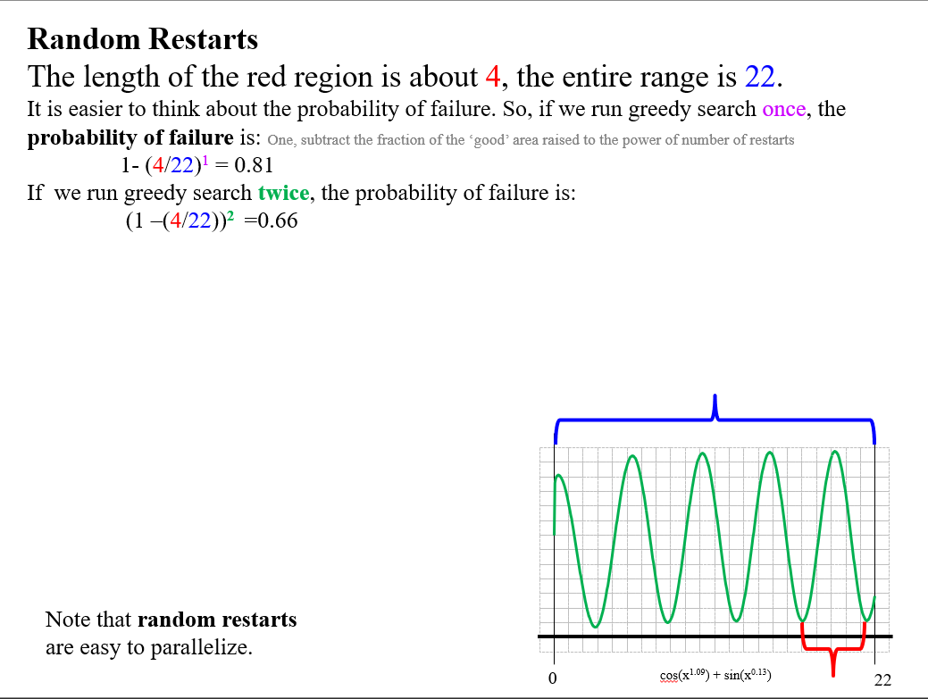

Slide 36
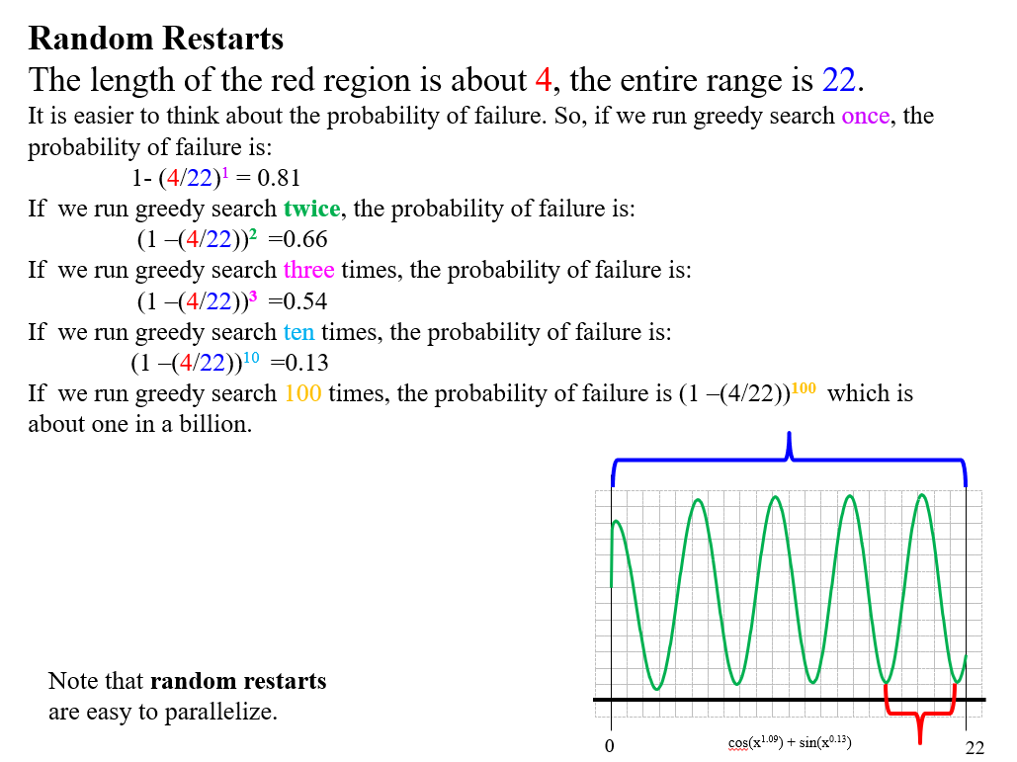

Slide 37
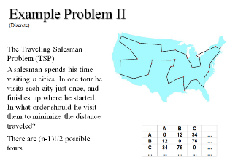

The local Maxima problem is not just for continuous spaces, it also happens in discrete spaces
For example you can use greedy search for the TSP problem. The algorithm is sometimes called the nearest neighbor (NN) algorithm and makes the salesman choose the nearest unvisited city at his next move
On average this gets you within 25% of the optimal solution
However, we can make problems for which this greedy algorithm would give you the worst route!
(let us create such a route in class.)

Slide 38

We have to start and end at A. Let us do 6 cities, from A to F
Let us build a worse case (as an aside, building worse cases is always a good idea to understand algorithms)

Slide 39
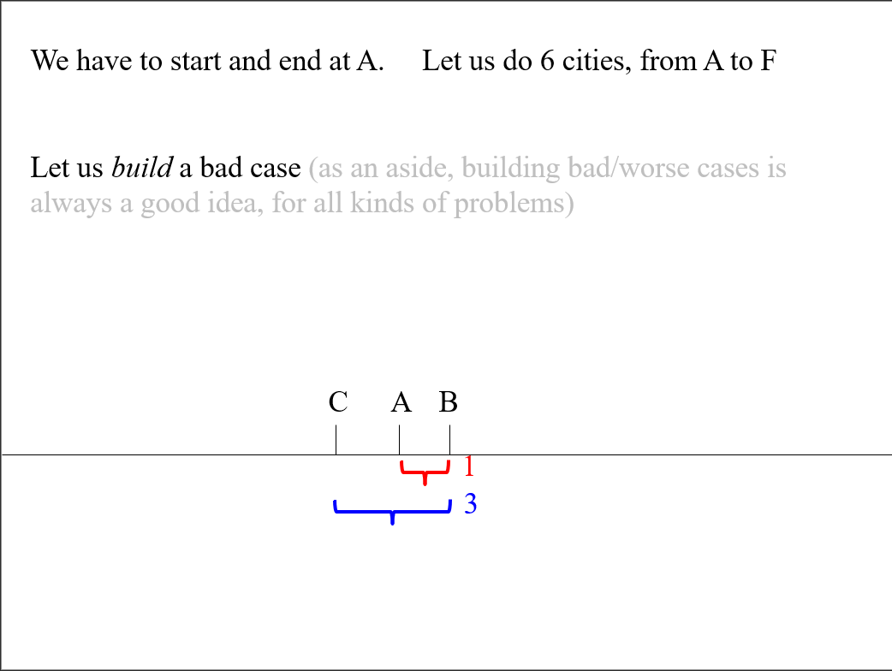

Slide 40
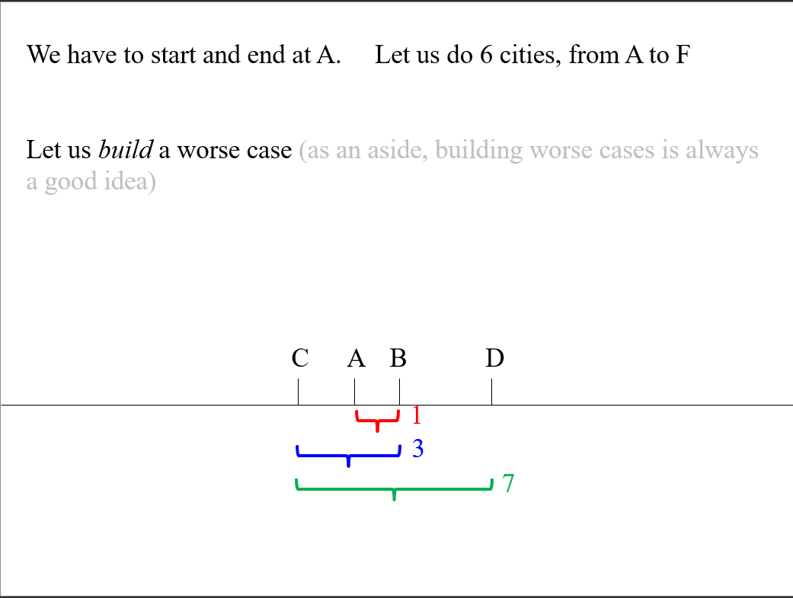

Slide 41
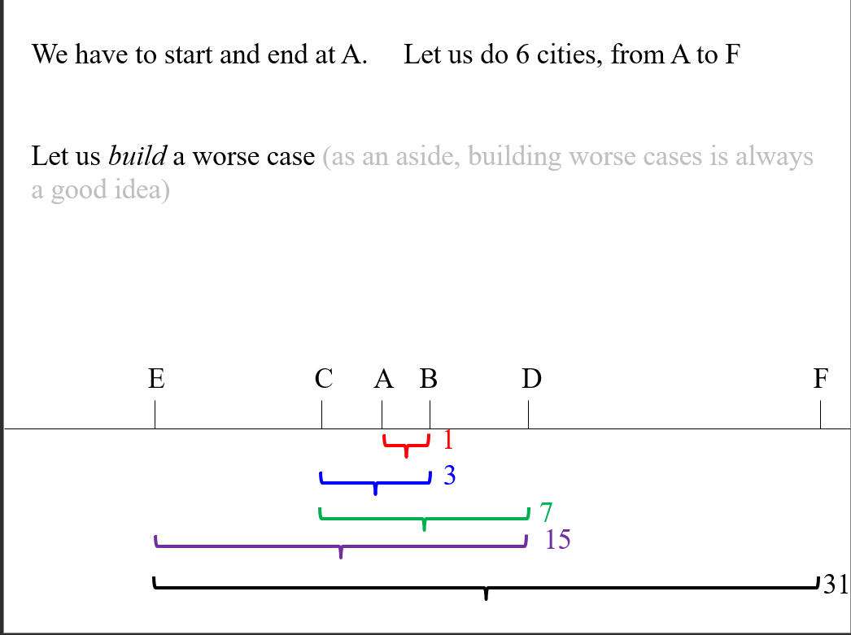

Slide 42
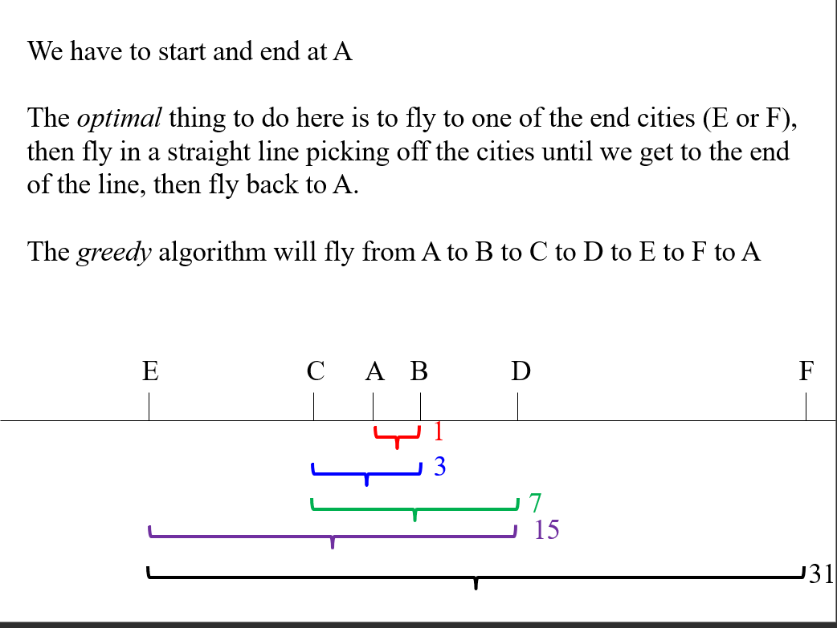

Slide 43
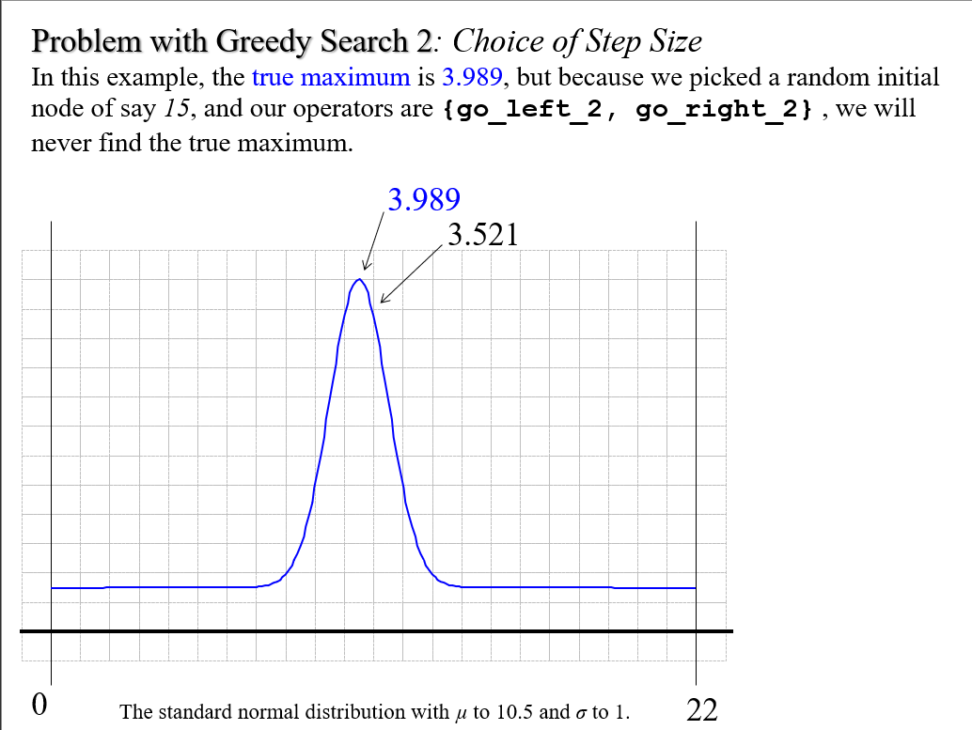

Slide 44
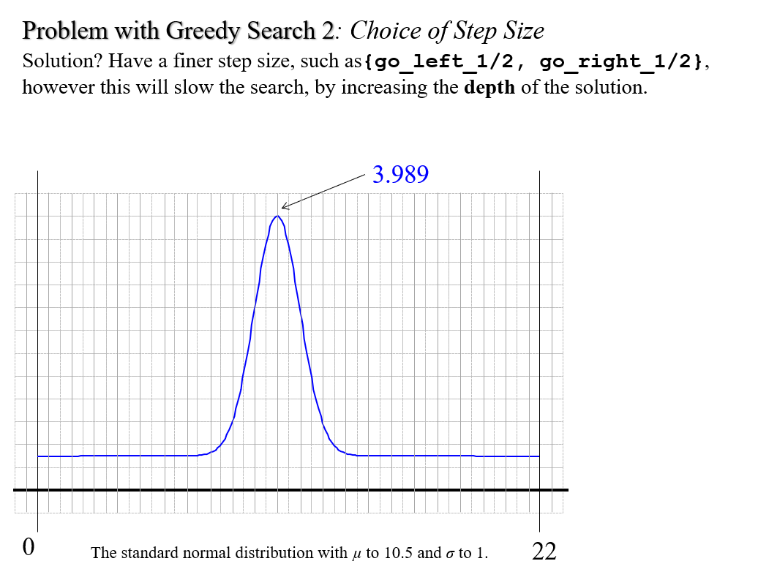

Slide 45
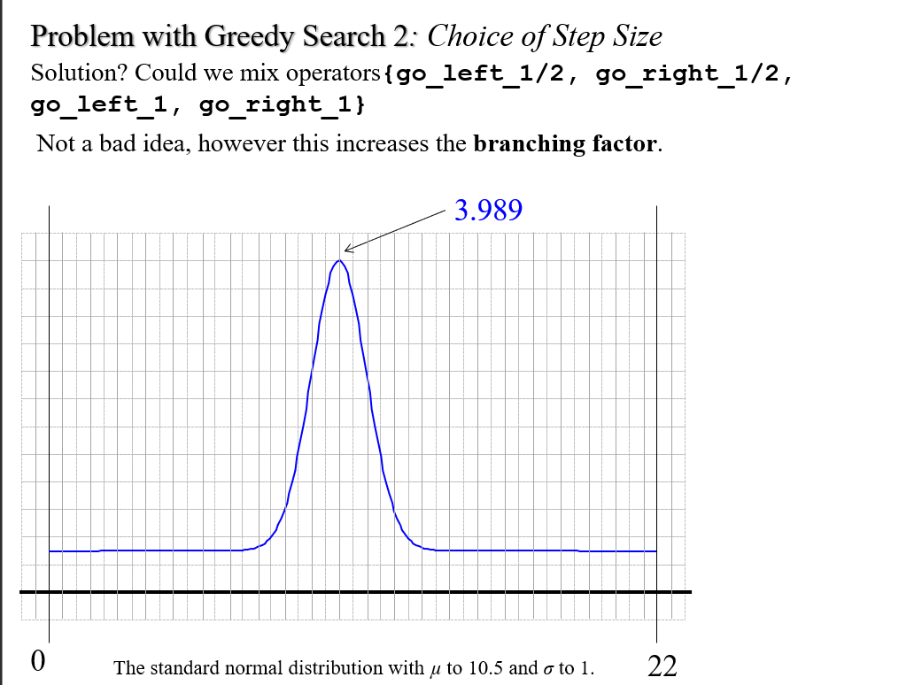

Slide 46
Dealing with Step Size Choice
There is a “trick” to deal with the problem of step size choice
We can adaptively learn the step size choice
We make the step proportional to the gradient of the function at the current point
However, for non-differentiable functions, gradient methods are ill-defined
3.521
0
The standard normal distribution with µ to 10.5 and σ to 1.
22

Slide 47
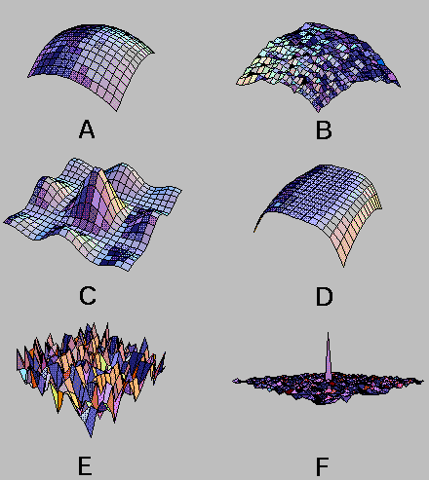
How would Hill-Climbing do on the following problems?
How can we improve Hill-Climbing?
Random restarts!
Intuition: can hill-climbing as many times as you can afford, choose the best answer.

Slide 48
By visual intuition.
What is the chance of finding the maximum with one random greedy search? With two random greedy searches…
If we run greedy search once, the probability of failure is:
1- (1/9)¹ = 0.88
If we run greedy search twice, the probability of failure is:
(1 –(1/9))² = 0.79
If we run greedy search one hundred times, the probability of failure is:
(1 –(1/9))¹⁰⁰ = 0.00000766
The probability of failure is: One, subtract the fraction of the ‘good’ area raised to the power of number of restarts

Slide 49
Simulated-Annealing
We have seen two optimizing search algorithms
Greedy Search: Very fast, but suboptimal
Random Search: Optimal, but very very very slow
We can try the classic CS idea of trying to combine them into a single algorithm that gets the best of both worlds
First note that we can see both as being a special case of a probabilistic operator choice
x = randumberbetween ([0 1])
if x > t, choose best operator, else choose random operator
If we set t to be 0, this is pure greedy search
If we set t to be 1, it is pure random search
If we set t to be in-between 0 and 1, it is partly random/partly greedy search.
t stands for “temperature”

